Slide 1
Practical Machine Learning
Week 4. Convolutional Neural Network
Jessee Kung

Slide 2
Outline
Lab 1. Recap of Neural Network
Lab 2. Convolutional Neural Network
Lab 3. Transfer Learning with Pre-trained Model

Slide 3
Lab 1. Recap of Neural Network

Slide 4
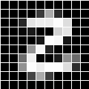
Recap 1. Basics of Neural Network
Start from 1 neuron:
Perceptron (感知機)
The simplest neural network (類神經網路)
Pixel 1
Pixel 2
Black
1
2
3
Black
k
Pixel3
Black
Model
Weights
…
Pixelk
White
99
100
…
Black
Receive signal from photo sensor
Determine the similarity between the input and weights
The weights is something like experiences
If similar → Trigger the signal
Pixel 99
Black
Pixel100

Slide 5
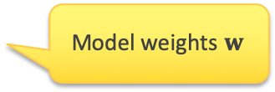
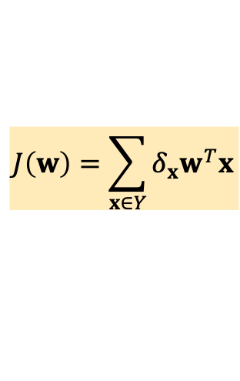
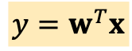
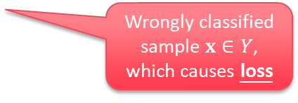
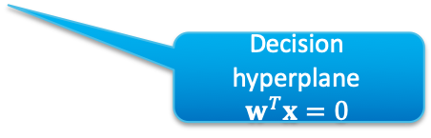
Recap 1. Basics of Neural Network
Perceptron - Neuron of fully-connected layer
Learning a model with the weights (experiences) similar to training data
For prediction:
Evaluate the similarity
Wrongly classified sample $x∈Y$, which causes loss
$$y=w^{T}x$$
For training:
Minimize the loss
Decision hyperplane
$$w^{T}x=0$$
$$J\left(w\right)=\sum_{x∈Y}{δ_{x}w^{T}x}$$
Model weights $w$
Set of wrongly classified samples

Slide 6
Recap 1. Basics of Neural Network
How to correct the model?
Reduce the loss → Reduce the wrongly classified samples
New decision hyperplane
New model weights

Slide 7
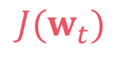
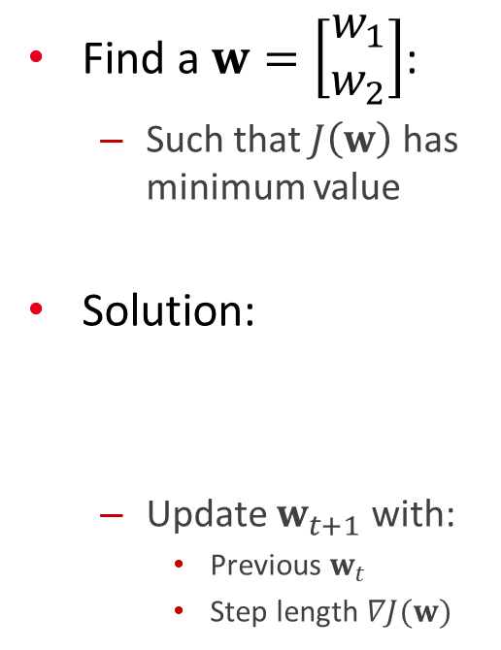
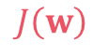
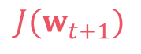
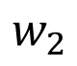
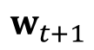
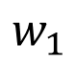
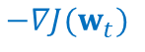
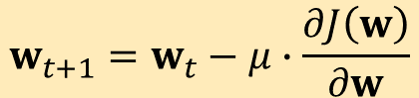
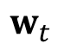
Recap 1. Basics of Neural Network
Find a $w=\left[\begin{matrix}w_{1} \\ w_{2}\end{matrix}\right]$:
Such that $J\left(w\right)$ has minimum value
Solution:
Update $w_{t+1}$ with:
Previous $w_{t}$
Step length $∇J(w)$
$$J\left(w\right)$$
$$J(w_{t})$$
$$J(w_{t+1})$$
$$w_{t+1}=w_{t}−μ∙\frac{∂J\left(w\right)}{∂w}$$
$$w_{t}$$
$$w_{t+1}$$
$$−∇J(w_{t})$$
$$w_{2}$$
$$w_{1}$$

Slide 8
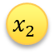
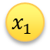
Recap 1. Basics of Neural Network
Multi-Layer Perceptron
$$x_{1}$$
Perceptron
Only handling with linear separable problem
Multi-Layer Perceptron
Handles complicate problems
Feature vector
$$x_{2}$$
Mis- classified
Mis- classified

Slide 9
Recap 4. Over-fitting vs. Under-fitting
Always divide the data into training set and testing set:
To make sure your model is capable of handling unseen samples
Real data distributions
Training samples collected
Real samples on production
You never have this!
The same distribution?

Slide 10
Recap 4. Over-fitting vs. Under-fitting
Always divide the data into training set and validation set:
To make sure your model is capable of handling unseen samples
Loss
Validation loss should be decreased with training loss
Validation loss
Training loss
Epochs (# iterations)
Training set
Validation set
Train a model by fitting the training set
Make sure the same model is also good for validation set

Slide 11
Recap 4. Over-fitting vs. Under-fitting
Model complexity not enough:
High training loss and high validation loss
Loss
Validation loss
Training loss
Epochs (# iterations)
Training set
Validation set
The model is not good enough for the training set …

Slide 12
Recap 4. Over-fitting vs. Under-fitting
Model complexity too high:
Low training loss and high validation loss
Loss
Validation loss
Training loss
Epochs (# iterations)
Training set
Validation set
The model is too good for fitting the training set …

Slide 13
Recap 4. Over-fitting vs. Under-fitting
Loss
Strategies for under-fitting:
Check for data quality
Check if methods worked
Check if model is too simple to accommodate complicate data distribution
Strategies for over-fitting:
Check the amount of your data
Adjust your model parameters
Decision tree based:
Reduce the #Leaves in child leaves
Reduce the tree heights
Neural network based: Reduce the number of layers
Validation loss
Training loss
Epochs (# iterations)
Loss
Validation loss
Training loss
Epochs (# iterations)

Slide 14
Lab 2. Convolutional Neural Network

Slide 15
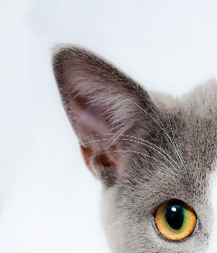
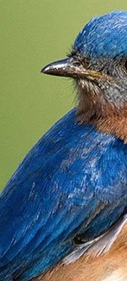
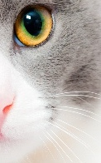
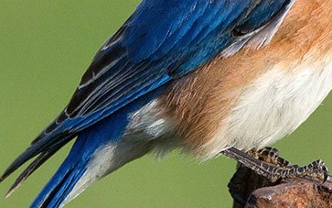
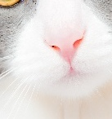
Review: Animal Guess
Animal Guess

Slide 16
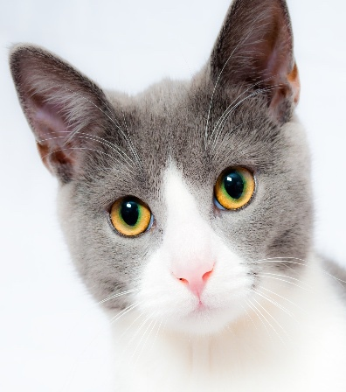
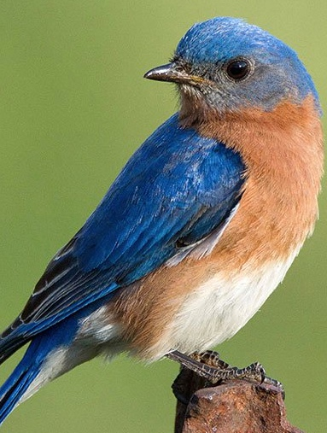
Review: Animal Guess
Animal Guess
You can figure out what type of animal it is by only parts of images

Slide 17
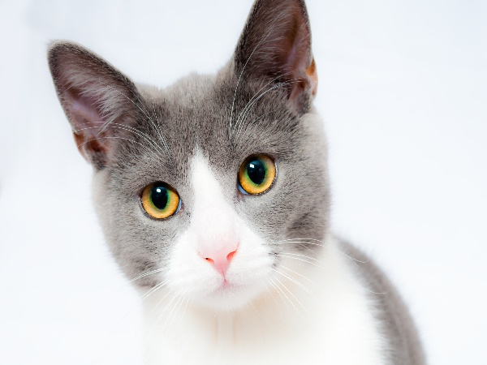
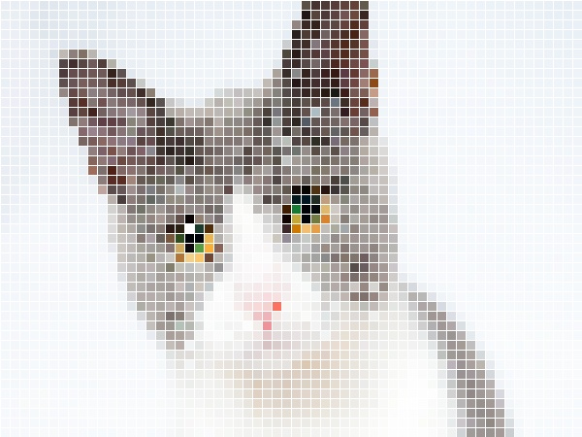
Convolutional Neural Network
For humans:
Image = A set of low-level features, aggregated hierarchically
Shapes (lines, triangle, circles, squares ., etc.) → Eyes, Beard, Mouth, Ear, ., etc. → Cat
For computers:
Image = A set of Pixels
The semantic information is needed to be formed hierarchically by pixel relations
Ear
Eyes
Nose, Mouth

Slide 18
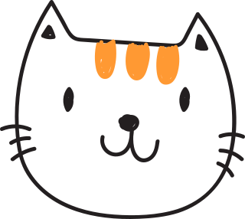

Convolutional Neural Network
Convolutional operator:
Build the relations of:
Pixel itself, and
Neighborhood pixels

Slide 19
Convolutional Neural Network
Convolutional layer:
Extract local semantic information by:
Convolution mask $w$
Local-parts of image $x$
Example:
2 convolution filters:
and
Hand-written digit input:
Digit 3 = 2 curved parts + 2 horizontal line …
Class = Digit 3
Activation Layer
Fully connected, Pooling, Dropout ., etc.
$${\left(x∗w\right)}_{ij}^{ℓ+1}=\sum_{m=0}^{k_{1}−1}{\sum_{n=0}^{k_{2}−1}{x_{i+m,j+n}^{ℓ}⋅w_{m,n}^{ℓ}+b}}$$
Convolutional Layer
Highlight the curved parts
Highlight the horizontal line parts

Slide 20
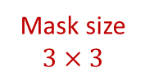
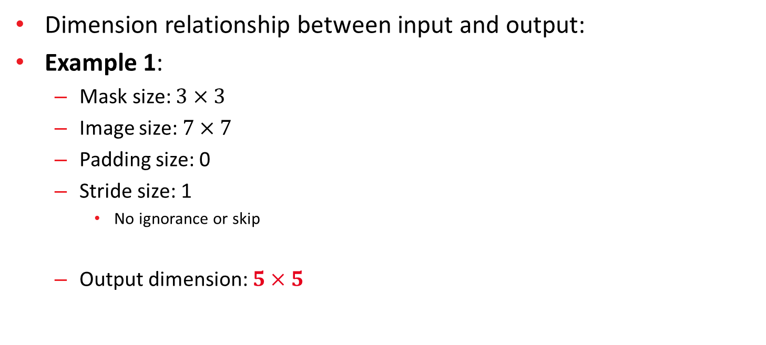
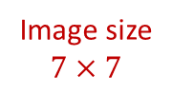
Convolutional Mask
Dimension relationship between input and output:
Example 1:
Mask size: $3×3$
Image size: $7×7$
Padding size: 0
Stride size: 1
No ignorance or skip
Output dimension: $5×5$
Mask size
$$3×3$$
Image size
$$7×7$$

Slide 21
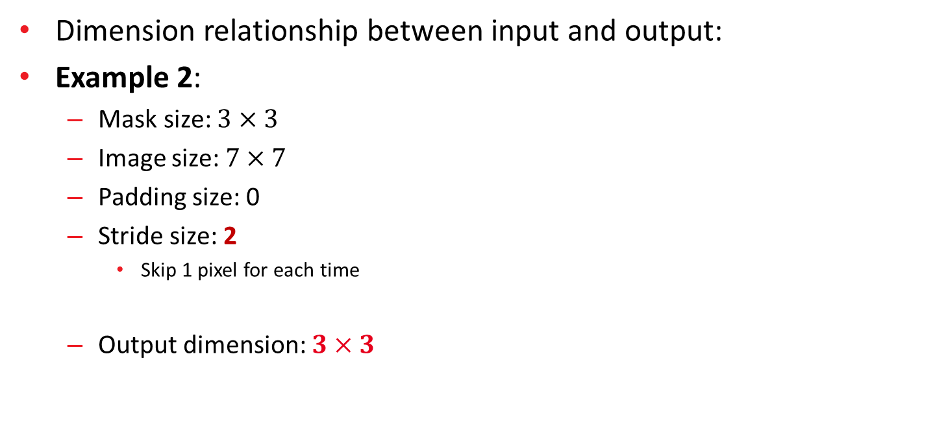
Convolutional Mask
Dimension relationship between input and output:
Example 2:
Mask size: $3×3$
Image size: $7×7$
Padding size: 0
Stride size: 2
Skip 1 pixel for each time
Output dimension: $3×3$
Mask size
$$3×3$$
Image size
$$7×7$$

Slide 22
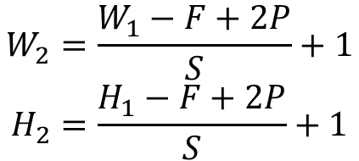
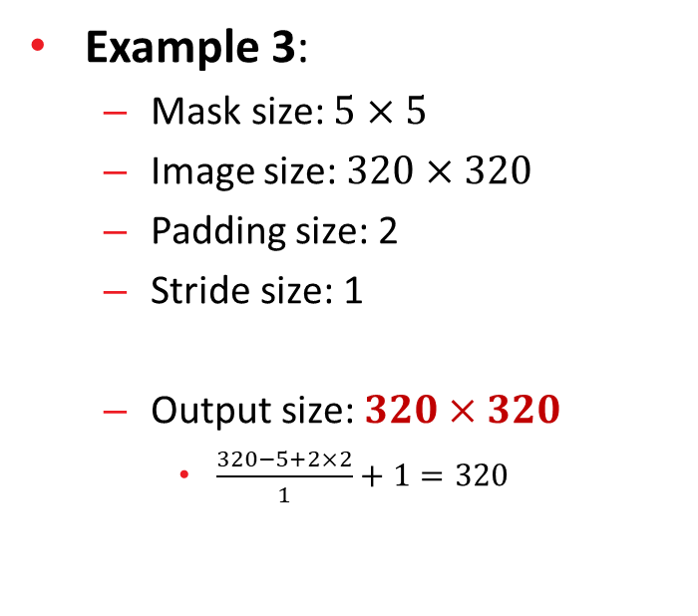
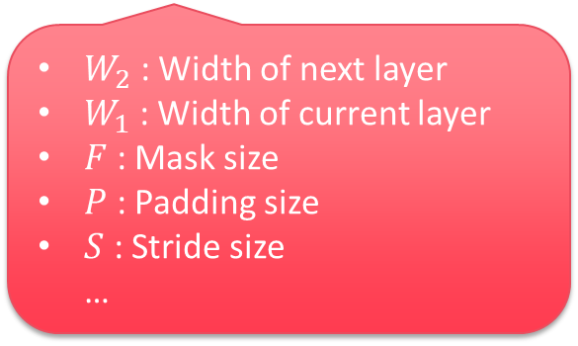
Convolutional Mask
Dimension relationship between input and output:
Example 3:
Mask size: $5×5$
Image size: $320×320$
Padding size: 2
Stride size: 1
Output size: $320×320$
$\frac{320−5+2×2}{1}+1=320$
Formula:
$$W_{2}=\frac{W_{1}−F+2P}{S}+1$$
$$H_{2}=\frac{H_{1}−F+2P}{S}+1$$
$W_{2}$ : Width of next layer
$W_{1}$ : Width of current layer
$F$ : Mask size
$P$ : Padding size
$S$ : Stride size …

Slide 23

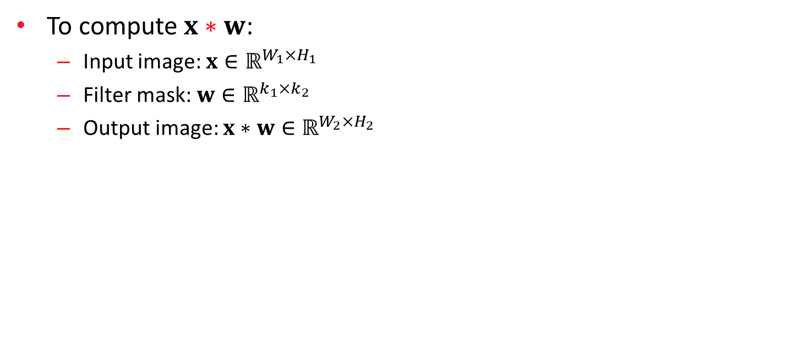



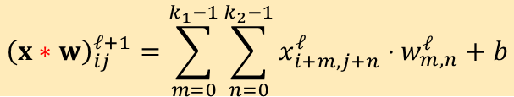


Convolutional Mask
To compute $x∗w$:
Input image: $x∈ℝ^{W_{1}×H_{1}}$
Filter mask: $w∈ℝ^{k_{1}×k_{2}}$
Output image: $x∗w∈ℝ^{W_{2}×H_{2}}$
$${\left(x∗w\right)}_{ij}^{ℓ+1}=\sum_{m=0}^{k_{1}−1}{\sum_{n=0}^{k_{2}−1}{x_{i+m,j+n}^{ℓ}⋅w_{m,n}^{ℓ}+b}}$$
-1 | 0 | +1
-1 | 0 | +1
-1 | 0 | +1
0 | 0 | 0 | 128 | 128 | 128 | 128
0 | 0 | 0 | 128 | 128 | 128 | 128
0 | 0 | 0 | 128 | 128 | 128 | 128
0 | 0 | 0 | 128 | 128 | 128 | 128
0 | 0 | 0 | 128 | 128 | 128 | 128
0 | 0 | 0 | 128 | 128 | 128 | 128
0 | 0 | 0 | 128 | 128 | 128 | 128
 | 0 | 384 | 384 | 0 | 0
 | 0 | 384 | 384 | 0 | 0
 | 0 | 384 | 384 | 0 | 0
 | 0 | 384 | 384 | 0 | 0
 | 0 | 384 | 384 | 0 | 0
$$k_{2}$$
$$H_{1}$$
$$H_{2}$$
$$k_{1}$$
$$W_{1}$$
$$W_{2}$$

Slide 24
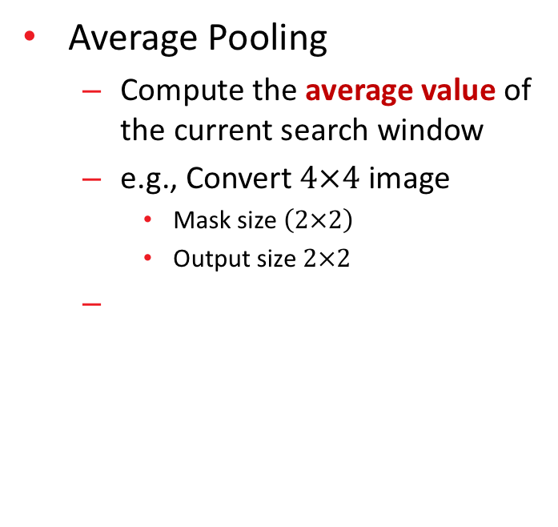
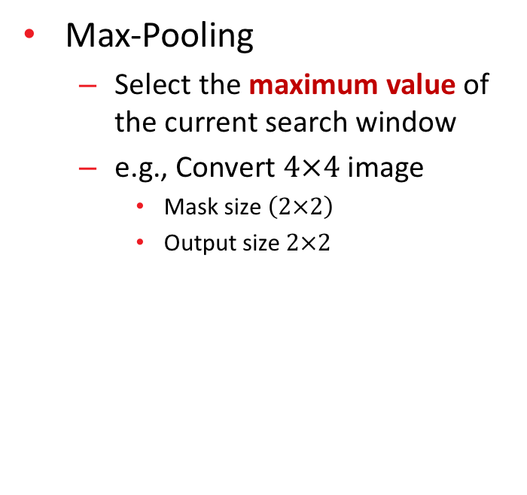
Pooling Layer
Max-Pooling
Select the maximum value of the current search window
e.g., Convert $4×4$ image
Mask size $\left(2×2\right)$
Output size $2×2$
Average Pooling
Compute the average value of the current search window
e.g., Convert $4×4$ image
Mask size $\left(2×2\right)$
Output size $2×2$
1 | 2 | 3 | 4
5 | 6 | 7 | 8
9 | 10 | 11 | 12
13 | 14 | 15 | 16
6 | 8
14 | 16
1 | 2 | 3 | 4
5 | 6 | 7 | 8
9 | 10 | 11 | 12
13 | 14 | 15 | 16
3.5 | 5.5
11.5 | 13.5

Slide 25

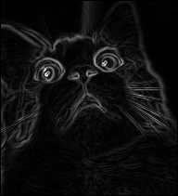
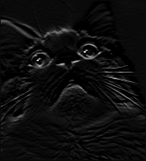
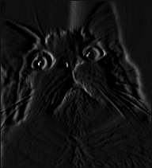
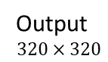
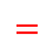
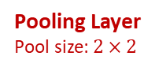
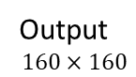
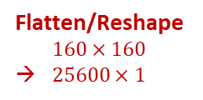

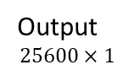

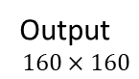
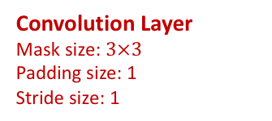









Convolutional Neural Network
Example:
Output
$$320×320$$
Output
$$160×160$$
255
120
…
127
Output
$$25600×1$$
$$∗$$
$$=$$
255
93
…
127
$$∗$$
$$=$$
Output
$$320×320$$
Output
$$160×160$$
Output$25600×1$
…
…
…
Fully Connected Layer
+
Activation Layer
Input Layer
$$320×320$$
255
120
…
127
$$∗$$
$$=$$
Output
$$320×320$$
Output
$$160×160$$
Output
$$25600×1$$
Convolution Layer
Mask size: $3×3$
Padding size: 1
Stride size: 1
Pooling Layer
Pool size: $2×2$
Flatten/Reshape $160×160$
→ $25600×1$
Notes:
Feed-forward http://cs231n.github.io/convolutional-networks/
Back-propagation
http://www.jefkine.com/general/2016/09/05/backpropagation-in-convolutional-neural-networks/

Slide 26





Dropout Layer
Randomly masked the activations of neurons:
The masked rate can be specified
e.g., 0.25, 0.5 ., etc.
Prevent over-fitting
Notice:
DO NOT appended in the last layer
Make sure model capacity is sufficient before dropout layer
Training time may be increased
$$x_{1}$$
$$x_{2}$$
$$x=\left[\begin{matrix}x_{1} \\ \begin{aligned}x_{2} \\ x_{3}\end{aligned} \\ \begin{aligned}⋮ \\ x_{l}\end{aligned}\end{matrix}\right]$$
$$x_{3}$$
$$x_{l}$$
Input Layer
Layer 1
Dropout

Slide 27
Batch Normalization Layer
Data normalization can benefit to the training task
2
$$x_{1}$$
1,3,2, … $x_{1}$
3200, 2400, 1952, … $x_{2}$
… $⋮$
15, 20, 18 … $x_{ℓ}$
$$w_{1}$$
$$w_{2}$$
$$y$$
1
$$w_{ℓ}$$
$$x_{2}$$
$$x_{1}$$
0.50, 0.89, 1.00, … $x_{1}$
0.45, 0.12, 0.13, … $x_{2}$
… $⋮$
0.72, 0.84, 0.68, … $x_{ℓ}$
$$w_{1}$$
$$w_{2}$$
$$y$$
2
$$w_{ℓ}$$
$$x_{2}$$
Prevent some feature dominates the cost function

Slide 28


Batch Normalization Layer
More details:
Example: Sigmoid activation function
With normalization:
Sufficient gradient back-propagated to the front layers
Increasing training speed
Without normalization:
Gradient saturation reduce the training speed
Normalized value range in the $[−1,1]$ prevents gradient saturation

Slide 29










































Batch Normalization Layer
Use batch normalization layer to enhance the training time:
Evaluate $μ$ and $σ$ for each dimension $j$
$${\tilde{x}}_{j}=\frac{{\tilde{x}}_{j}−μ}{σ}$$
$$x_{1}$$
$$x_{1}$$
$$x_{1}$$
$$x_{1}$$
$$x_{1}$$
$$x_{1}$$
$${\tilde{x}}_{1}$$
$$x_{1}$$
$${\tilde{x}}_{1}$$
$$x_{1}$$
$${\tilde{x}}_{1}$$
$$x_{1}$$
$$x_{2}$$
$$x_{1}$$
$$x_{2}$$
$$x_{2}$$
$$x_{2}$$
$$x_{2}$$
$$x_{2}$$
$${\tilde{x}}_{2}$$
$$x_{2}$$
$${\tilde{x}}_{2}$$
$$x_{2}$$
$${\tilde{x}}_{2}$$
…
…
…
$$x_{3}$$
$$x_{3}$$
$$x_{3}$$
$$x_{3}$$
$$x_{3}$$
$$x_{3}$$
$${\tilde{x}}_{3}$$
$$x_{3}$$
$${\tilde{x}}_{3}$$
$$x_{3}$$
$$x_{2}$$
$${\tilde{x}}_{3}$$
$$x_{2}$$
…
…
…
…
…
…
…
…
…
$$x_{d_{ℓ−1}}$$
$$x_{d_{ℓ−1}}$$
$$x_{d_{ℓ−1}}$$
$$x_{d_{ℓ−1}}$$
$$x_{d_{ℓ}}$$
$$x_{d_{ℓ}}$$
$${\tilde{x}}_{d_{ℓ}}$$
$$x_{d_{ℓ}}$$
$${\tilde{x}}_{d_{ℓ}}$$
$$x_{d_{ℓ}}$$
$${\tilde{x}}_{d_{ℓ}}$$
$$x_{1}$$
$$x_{2}$$
$$x_{M}$$
$$x_{1}$$
$${\tilde{x}}_{1}$$
$$x_{2}$$
$${\tilde{x}}_{2}$$
$$x_{M}$$
Input
Layer $ℓ$
Batch Norm
$${\tilde{x}}_{M}$$

Slide 30
Lab 3. Transfer Learning with Pre-trained Model
Please refer to the jupyter notebook

Slide 31
Lab / Homework
Please finish the Your task part in the Jupyter notebook
Lab 1. Required
Lab 2. and Lab3.: Select one of them and finish it
Share and submit your Colab notebook:
https://forms.gle/Hkk7WS2BDsmwGovE8

